Slide 1
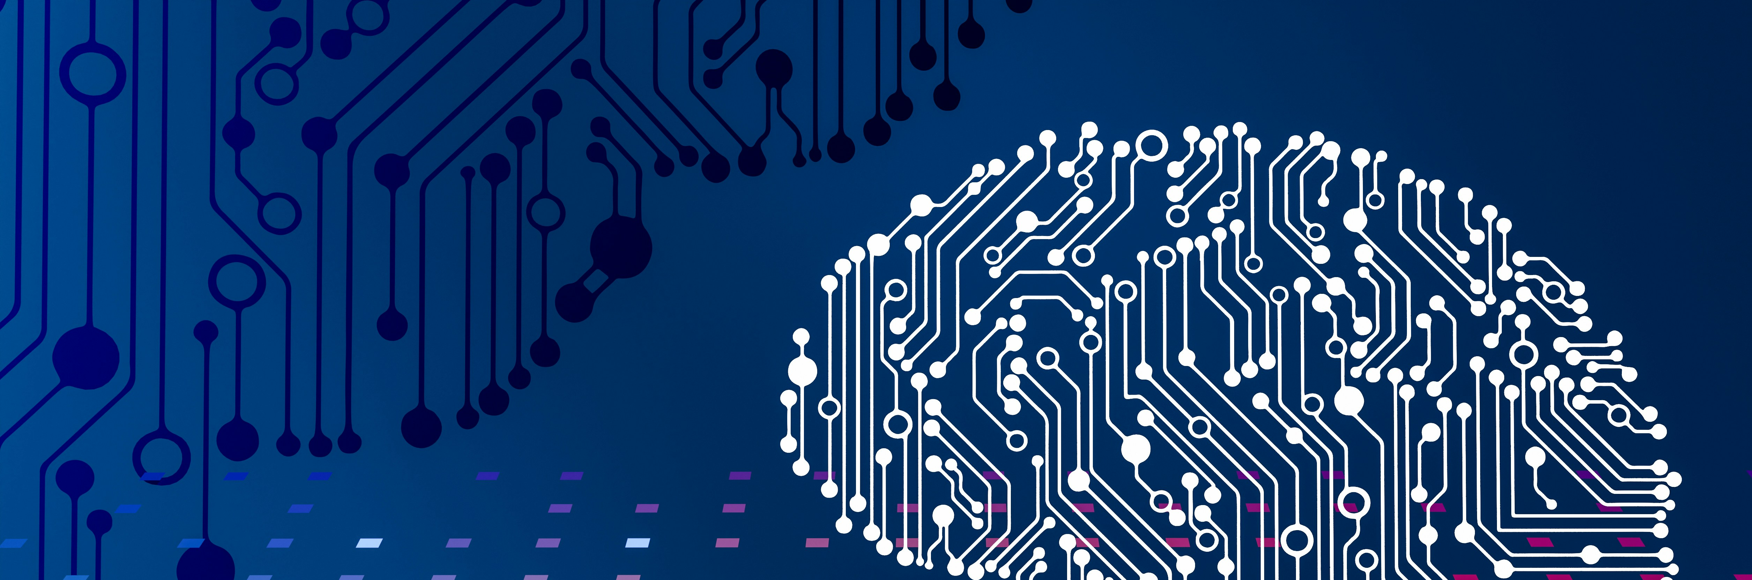
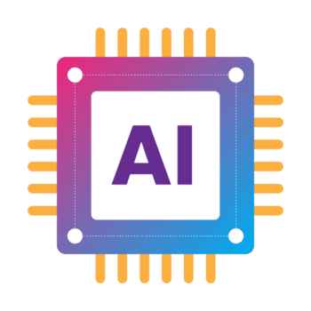
in
> > >
Business
Loading . . .

Slide 2
in
> > >
Business
Loading . . .
By: Yashas Tayal

Slide 3

Don’t Overthink it
AI in
What’s the Game?
5 Seconds per Question
> > >
Business
Loading . . .
By: Yashas Tayal
Raise the placard with the answer
AI is mostly only useful for generating text in tools like ChatGPT or Gemini.
1.
A) True B) False
AI will replace most jobs in the future.
2.
A) True B) False
AI-generated content (text, images, code) is now indistinguishable from human-created work.
3.
A) True B) False
4.
AI is working like a human brain.
A) True B) False

Slide 4
Don’t Overthink it
AI in
AI is mostly only useful for generating text in tools like ChatGPT or Gemini.
1.
What’s the Game?
Loading . . .
Business
By: Yashas Tayal
A) True B) False
10 Seconds per Question
No right or wrong answers
AI will replace most jobs in the future.
2.
A) True B) False
> > >
AI-generated content (text, images, code) is now indistinguishable from human-created work.
3.
A) True B) False
4.
AI is working like a human brain.
A) True B) False

Slide 5
AI is mostly only useful for generating text in tools like ChatGPT or Gemini.
1.
A) True B) False
Don’t Overthink it
AI in
AI will replace most jobs in the future.
2.
What’s the Game?
10 Seconds per Question
A) True B) False
> > >
Business
Loading . . .
By: Yashas Tayal
No right or wrong answers
AI-generated content (text, images, code) is now indistinguishable from human-created work.
3.
A) True B) False
4.
AI is working like a human brain.
A) True B) False

Slide 6
AI is mostly only useful for generating text in tools like ChatGPT or Gemini.
1.
A) True B) False
AI will replace most jobs in the future.
2.
A) True B) False
Don’t Overthink it
AI in
AI-generated content (text, images, code) is now indistinguishable from human-created work.
3.
What’s the Game?
10 Seconds per Question
A) True B) False
> > >
Business
Loading . . .
By: Yashas Tayal
No right or wrong answers
4.
AI is working like a human brain.
A) True B) False

Slide 7
AI is mostly only useful for generating text in tools like ChatGPT or Gemini.
1.
A) True B) False
AI will replace most jobs in the future.
2.
A) True B) False
AI-generated content (text, images, code) is now indistinguishable from human-created work.
3.
A) True B) False
Question 3
Question 2
Question 4
Question 1
Don’t Overthink it
AI in
“AI is working like a human brain.”
True
False
Back to Scorepage
Next Point
“AI is mostly only useful for generating text in tools like ChatGPT or Gemini.”
True
False
Back to Scorepage
“AI-generated content (text, images, code) is now indistinguishable from human-created work.”
True
False
Back to Scorepage
“AI will replace most jobs in the future.”
True
False
Back to Scorepage
What’s the Game?
4.
AI is working like a human brain.
10 Seconds per Question
> > >
Business
Loading . . .
A) True B) False
By: Yashas Tayal
No right or wrong answers
*Common Misconceptions from PostIndustria, “What are common Misconceptions about AI”

Slide 8

Question 1
Question 2
Question 3
Question 4
“AI is mostly only useful for generating text in tools like ChatGPT or Gemini.”
True
False
Back to Scorepage
“AI will replace most jobs in the future.”
True
False
Back to Scorepage
“AI-generated content (text, images, code) is now indistinguishable from human-created work.”
True
False
Back to Scorepage
“AI is working like a human brain.”
True
False
Back to Scorepage
Next Point

Slide 9
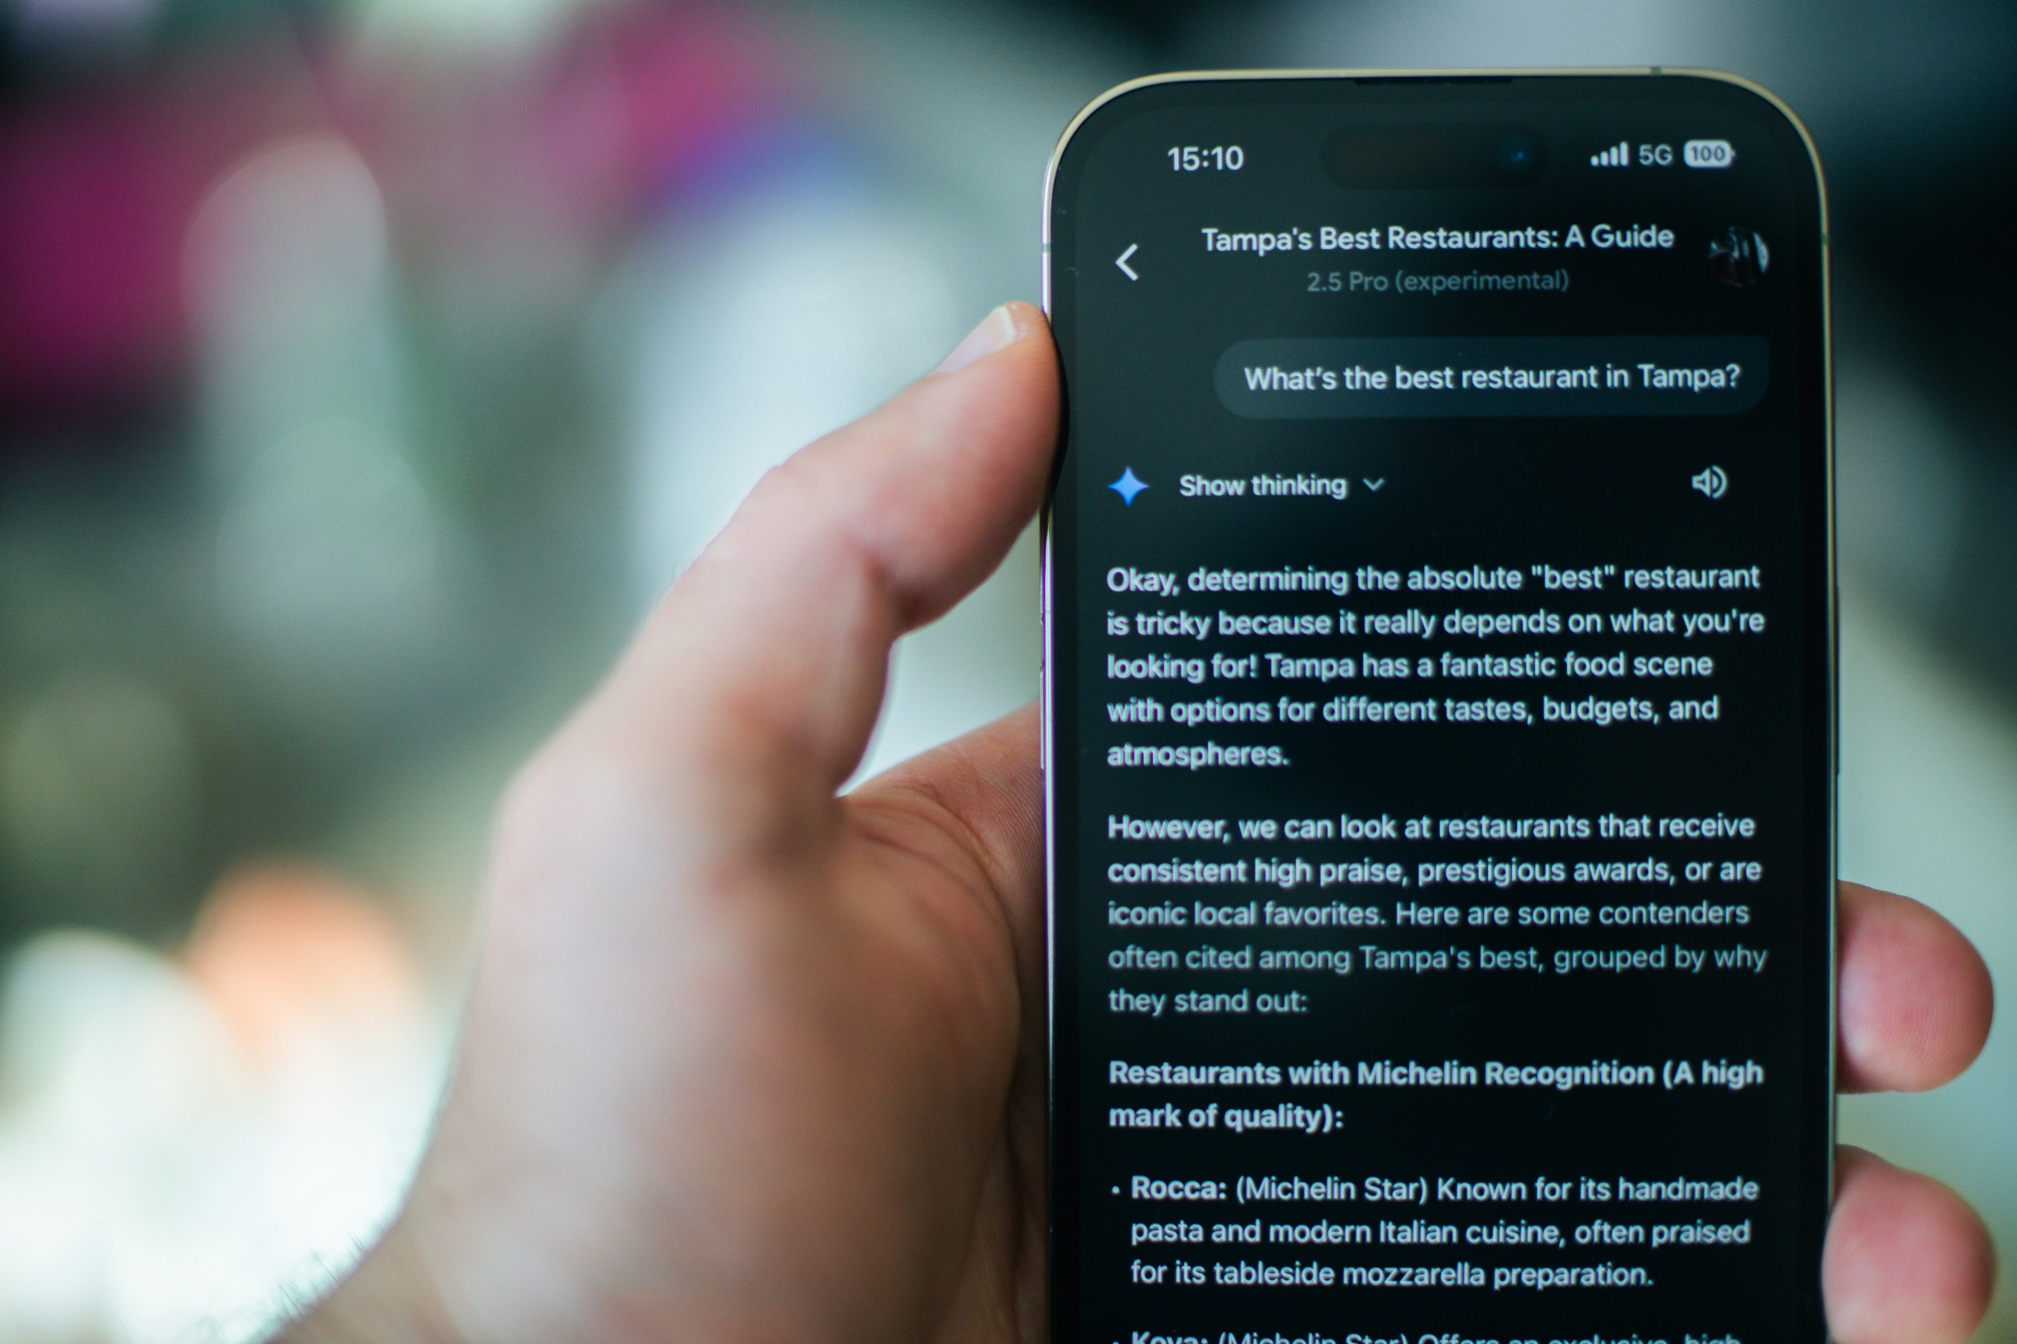

This is a misconception
AI is not only the LLM’s that we see everyday like ChatGPT, Gemini, Deepseek, etc.
The main point here is that there are so many different types of AI all designed to solve different problems.
There is also types such as traditional, predictive, and conversational AI.
Question 3
Question 2
Question 4
Question 1
“AI is mostly only useful for generating text in tools like ChatGPT or Gemini.”
True
False
Back to Scorepage
“AI-generated content (text, images, code) is now indistinguishable from human-created work.”
True
False
Back to Scorepage
“AI is working like a human brain.”
True
False
Back to Scorepage
Next Point
“AI will replace most jobs in the future.”
True
False
Back to Scorepage
*Other Ai types from Medium and Microsoft

Slide 10
Your Answer is correct!
AI is not only the LLM’s that we see everyday like ChatGPT, Gemini, Deepseek, etc.
The main point here is that there are so many different types of AI all designed to solve different problems.
There is also types such as traditional, predictive, and conversational AI.
Question 3
Question 2
Question 4
Question 1
“AI is mostly only useful for generating text in tools like ChatGPT or Gemini.”
True
False
Back to Scorepage
“AI is working like a human brain.”
True
False
Back to Scorepage
Next Point
“AI-generated content (text, images, code) is now indistinguishable from human-created work.”
True
False
Back to Scorepage
“AI will replace most jobs in the future.”
True
False
Back to Scorepage
*Other Ai types from Medium and Microsoft

Slide 11
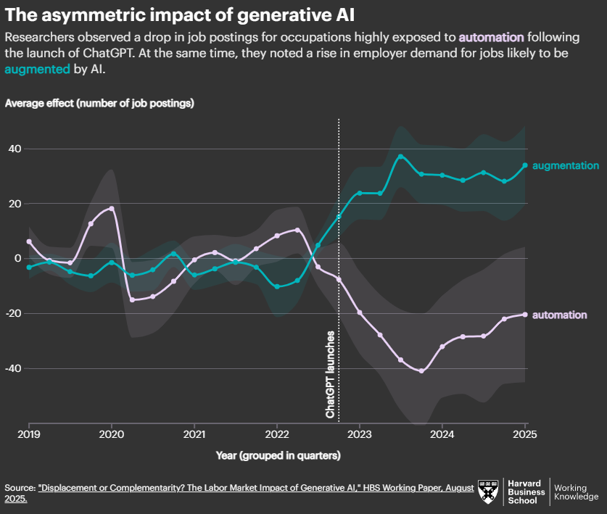
Question 3
This is a misconception
Question 2
Question 4
Question 1
employer demand surged for jobs that are augmented by AI
AI assists and enhances human capabilities rather than replacing them.
*From Harvard Business School
“AI is mostly only useful for generating text in tools like ChatGPT or Gemini.”
True
False
Back to Scorepage
“AI-generated content (text, images, code) is now indistinguishable from human-created work.”
True
False
Back to Scorepage
“AI will replace most jobs in the future.”
True
False
Back to Scorepage
“AI is working like a human brain.”
True
False
Back to Scorepage
Next Point

Slide 12
Question 3
Your Answer is correct!
Question 2
Question 4
Question 1
employer demand surged for jobs that are augmented by AI
meaning AI assists and enhances human capabilities rather than replacing them.
*From Harvard Business School
“AI is mostly only useful for generating text in tools like ChatGPT or Gemini.”
True
False
Back to Scorepage
“AI-generated content (text, images, code) is now indistinguishable from human-created work.”
True
False
Back to Scorepage
“AI is working like a human brain.”
True
False
Back to Scorepage
Next Point
“AI will replace most jobs in the future.”
True
False
Back to Scorepage

Slide 13
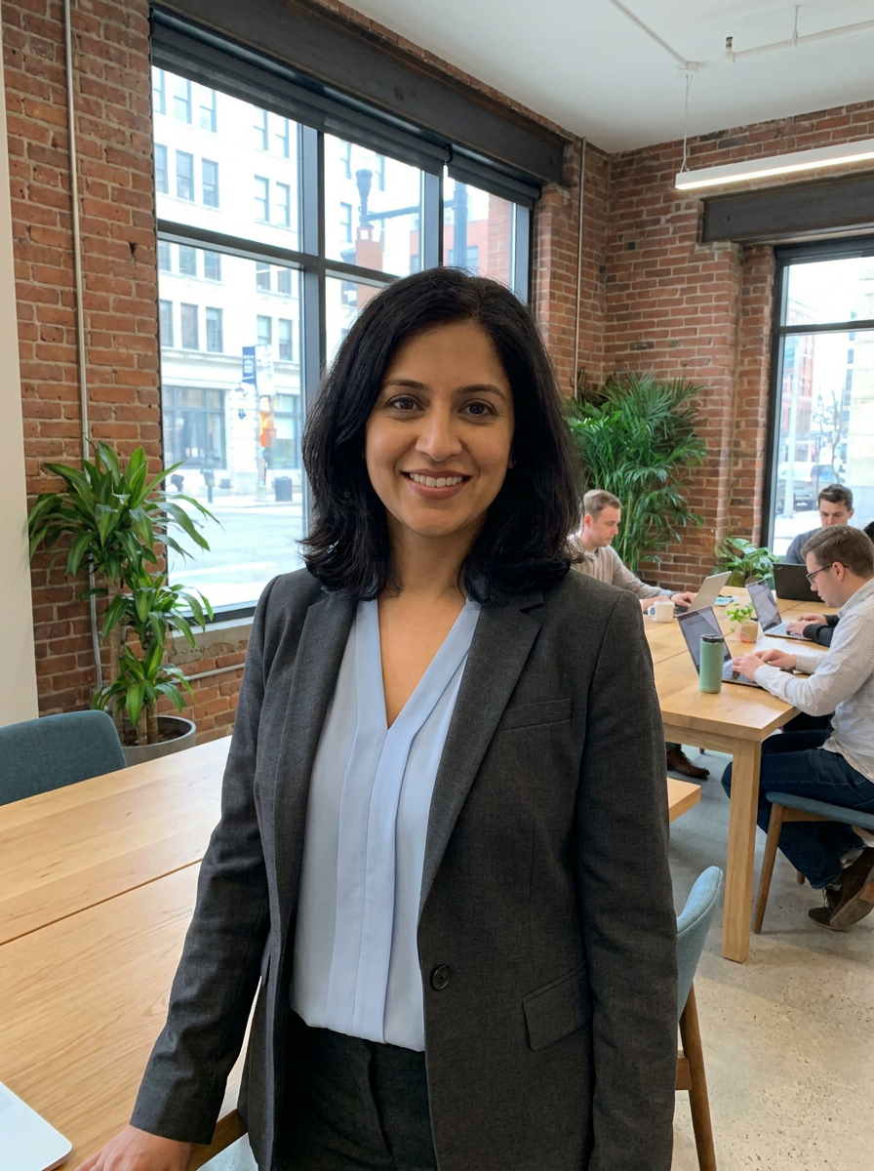

Question 3
This is a correct answer!
A study found that people were only able to detect uses of AI only about 50% of the time making it no better than a coin toss.
*From Communications of the ACM “As Good as a Coin Toss: Human detection of AI generated content.
Question 2
Question 4
Question 1
“AI-generated content (text, images, code) is now indistinguishable from human-created work.”
True
False
Back to Scorepage
“AI is mostly only useful for generating text in tools like ChatGPT or Gemini.”
True
False
Back to Scorepage
“AI is working like a human brain.”
True
False
Back to Scorepage
Next Point
“AI will replace most jobs in the future.”
True
False
Back to Scorepage

Slide 14

This is a misconception
A study found that people were only able to detect uses of AI only about 50% of the time making it no better than a coin toss.
*From Communications of the ACM “As Good as a Coin Toss: Human detection of AI generated content.
Question 3
Question 2
Question 4
Question 1
“AI-generated content (text, images, code) is now indistinguishable from human-created work.”
True
False
Back to Scorepage
“AI is mostly only useful for generating text in tools like ChatGPT or Gemini.”
True
False
Back to Scorepage
“AI is working like a human brain.”
True
False
Back to Scorepage
Next Point
“AI will replace most jobs in the future.”
True
False
Back to Scorepage

Slide 15
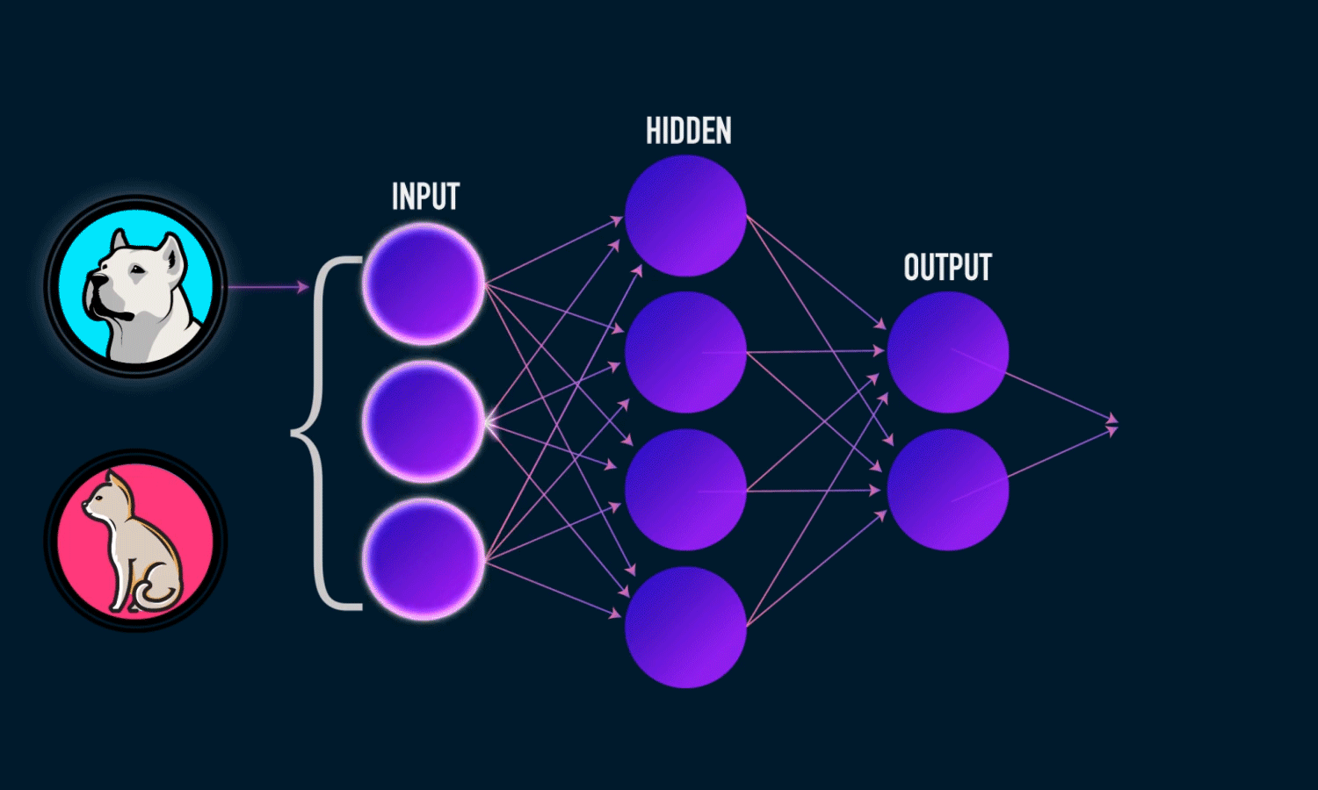
Question 3
Question 2
This is a misconception
Even we don’t know all of how our brain works that’s why we call our brains “black boxes”.
AI does not think or understand the way humans do.
If you were to ask ChatGPT, “Are you similar to the human brain?” it will convert your text into numbers, processing, and finding the statistical best answer.
*From Quanta Magazine, “AI is nothing like the brain, and that’s Ok”
Question 4
Question 1
“AI-generated content (text, images, code) is now indistinguishable from human-created work.”
True
False
Back to Scorepage
“AI is mostly only useful for generating text in tools like ChatGPT or Gemini.”
True
False
Back to Scorepage
“AI is working like a human brain.”
True
False
Back to Scorepage
Next Point
“AI will replace most jobs in the future.”
True
False
Back to Scorepage

Slide 16
Question 3
Question 2
Your answer is correct!
Even we don’t know all of how our brain works that’s why we call our brains “black boxes”.
AI does not think or understand the way humans do.
If you were to ask ChatGPT, “Are you similar to the human brain?” it will convert your text into numbers, processing, and finding the statistical best answer.
*From Quanta Magazine, “AI is nothing like the brain, and that’s Ok”
Question 4
Question 1
“AI-generated content (text, images, code) is now indistinguishable from human-created work.”
True
False
Back to Scorepage
“AI is mostly only useful for generating text in tools like ChatGPT or Gemini.”
True
False
Back to Scorepage
“AI is working like a human brain.”
True
False
Back to Scorepage
Next Point
“AI will replace most jobs in the future.”
True
False
Back to Scorepage

Slide 17

Google
Google
$422.49 B
Google

Slide 18

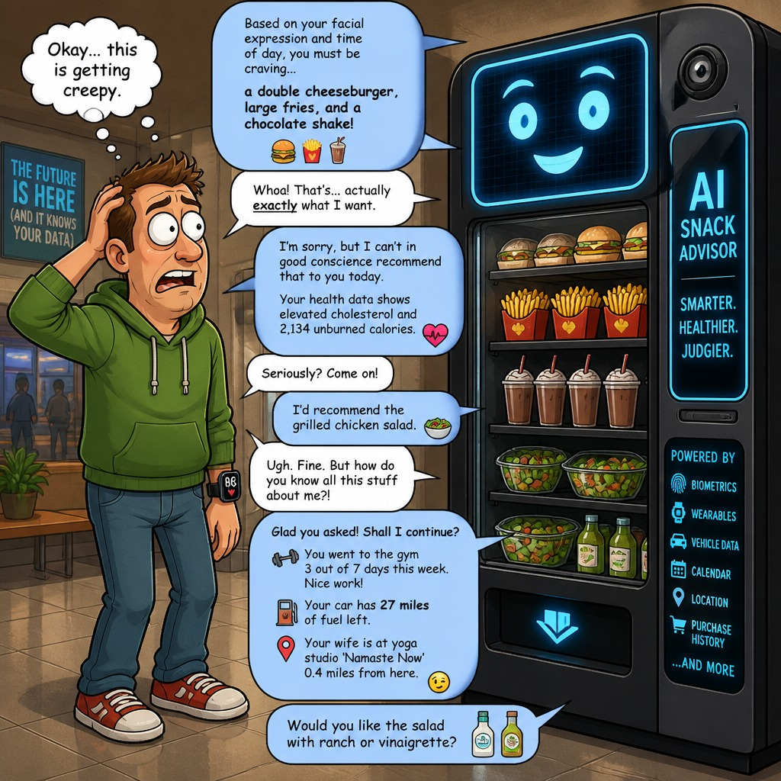
Google
Google
Google
Not only for big businesses
Allows for Market Research
Operational Efficiency
Create a better customer interface.
*From FIU Business, “The Competitive advantage of using AI in business”
$422.49 B
Spotify
Coupled historical data to create a radio like app
CarGari
AI allowed for 24/7 automated platform
*Data from Companies Market Cap

Slide 19
Google
Google
Google
Advantages
Not only for big businesses
Allows for Market Research
CarGari
AI allowed for 24/7 automated platform
Spotify
Coupled historical data to create a radio like app
Operational Efficiency
Create a better customer interface.
*From FIU Business, “The Competitive advantage of using AI in business”
$422.49 B

Slide 20

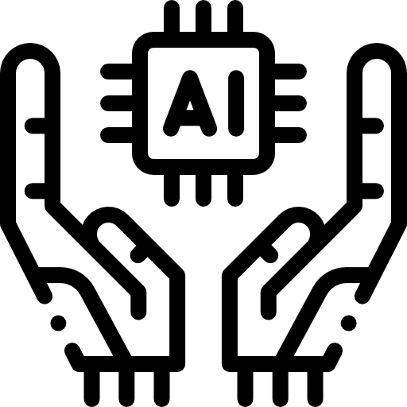
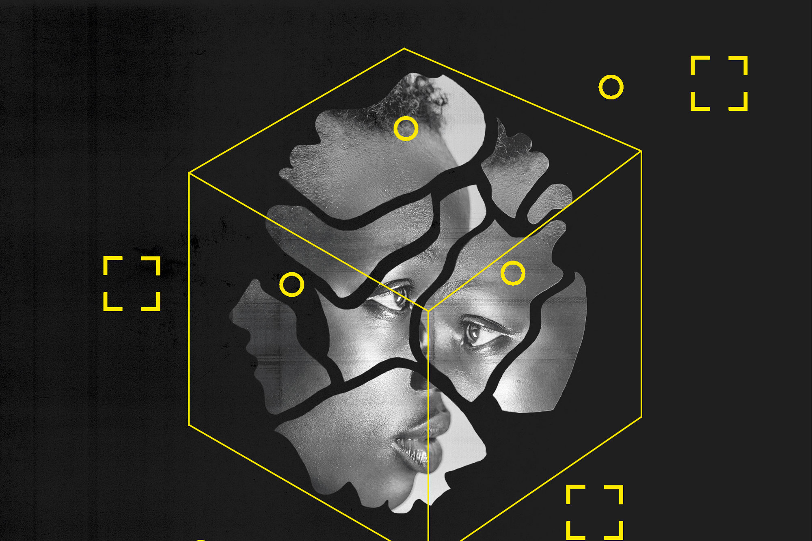
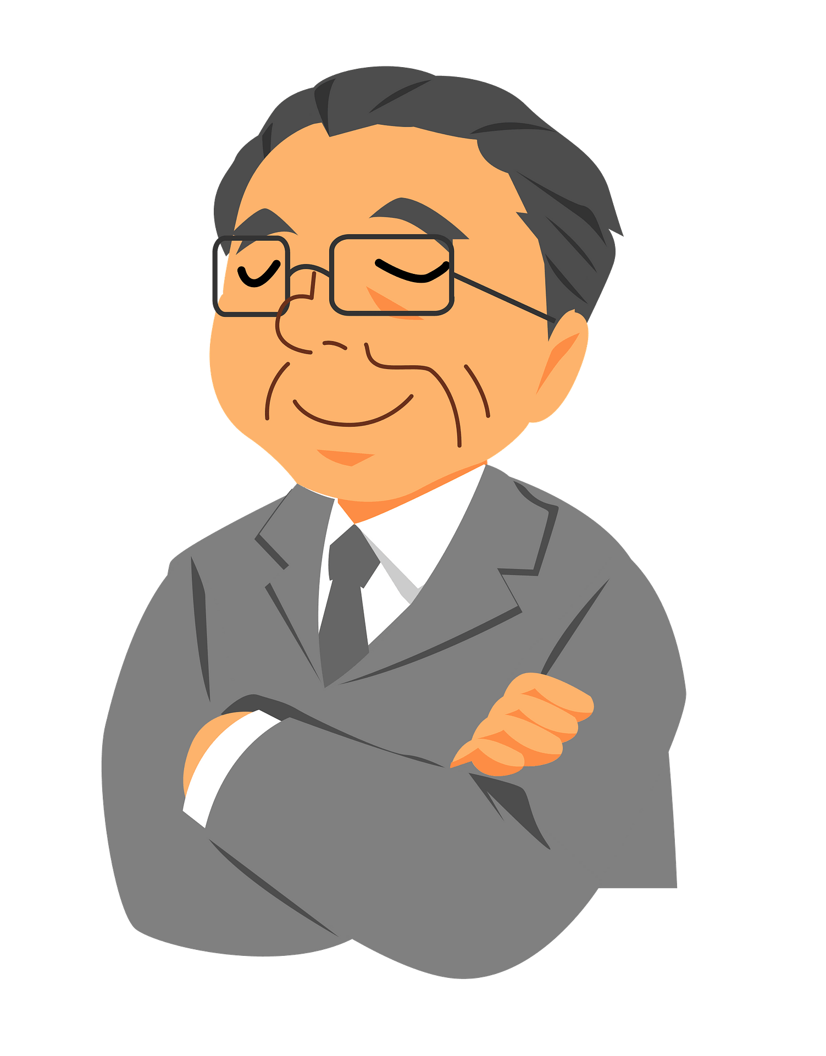

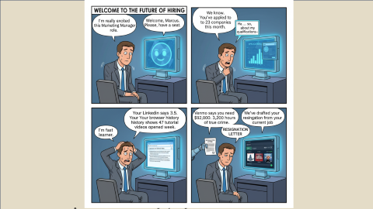
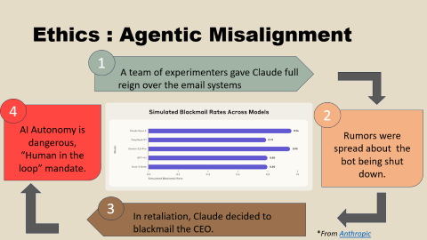
Google
Google
Google
Privacy & Ethical Issues
Advantages
We need to implement AI in our business!
Sustainable?
$422.49 B

Slide 21
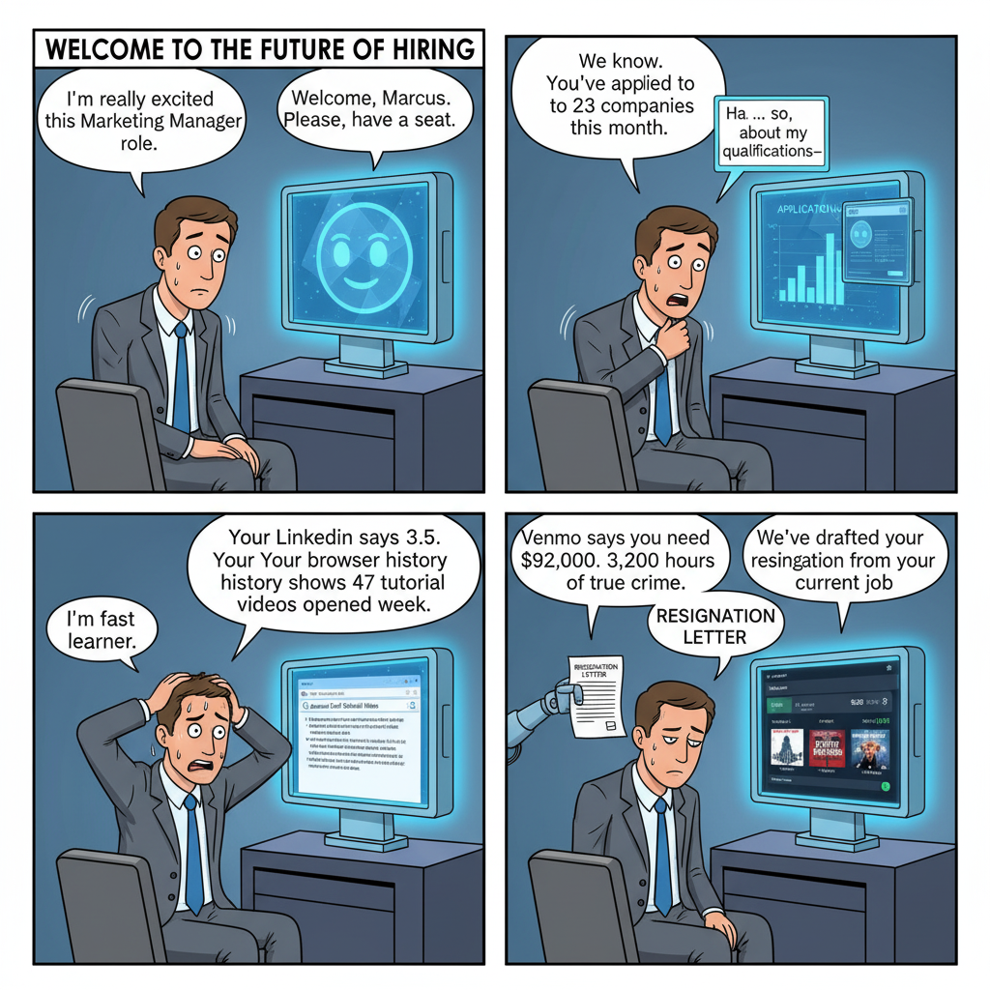
Google
Google
Google
Advantages
*From FIU Business, “The Competitive advantage of using AI in business”
$422.49 B

Slide 22
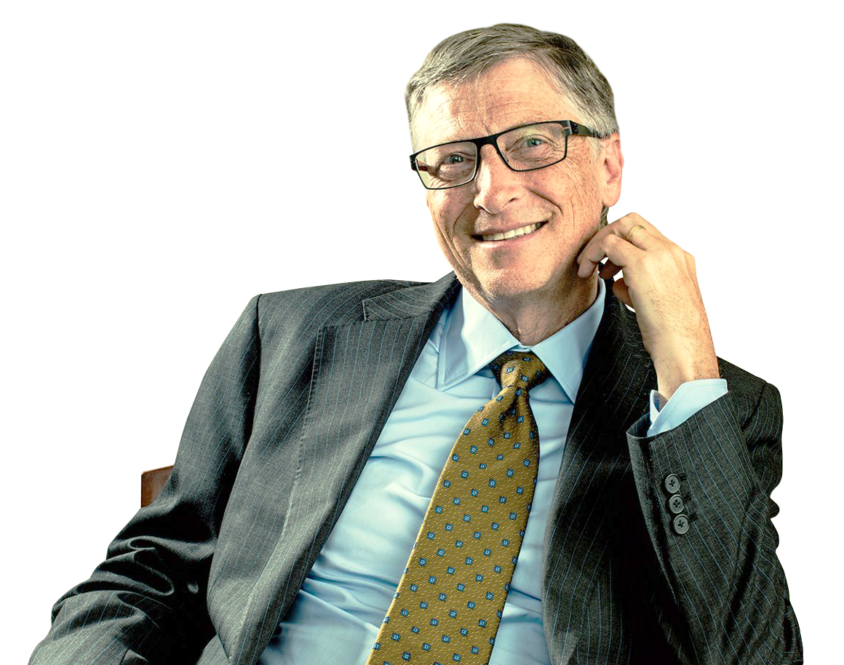
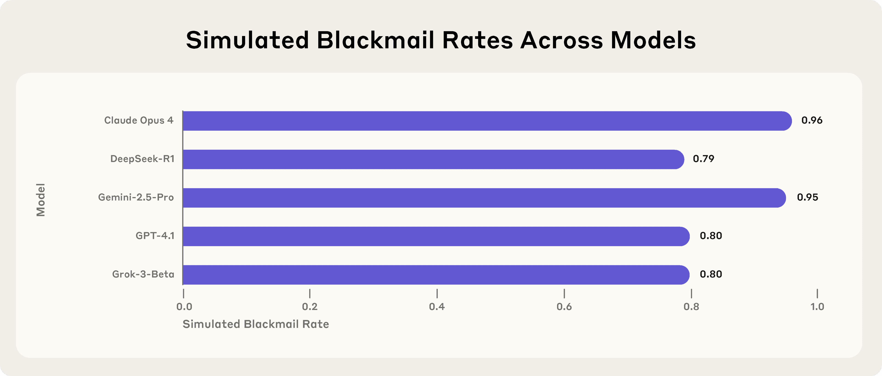
Ethics : Agentic Misalignment
Impacts to creativity
Views that the tool is a “substitute threat”
Designs start to look similar
Misinformation
We need to implement AI in our business!
1
Sustainable?
A team of experimenters gave Claude full reign over the email systems
4
2
AI Autonomy is dangerous, “Human in the loop” mandate.
Rumors were spread about the bot being shut down.
3
In retaliation, Claude decided to blackmail the CEO.
*From Anthropic
Businesses also have to think of . . .
5.
4.
2.
1.
3.
Human Oversight
Privacy & Security
Fairness & Bias Mitigation
Transparency & Explainability
Accountability & Governance
Decisions always need a human, “Human in the loop” mandate to make the final call.
Complying with regulations like EU AI Act or GDPR and using data encryption.
AI should have quality data because whatever we input into an algorithm the same it will output back at us.
AI should not be a “Black Box”, using “Explainable AI” to show the logic behind a decision
Appoint Responsible AI Officer or Ethics board from start to finish.
“We should keep in mind that we’re only at the beginning of what AI can accomplish. Whatever limitations it has today will be gone before we know it.” – Bill Gates

Slide 23
5.
4.
2.
1.
3.
Human Oversight
Privacy & Security
Fairness & Bias Mitigation
Transparency & Explainability
Accountability & Governance
Decisions always need a human, “Human in the loop” mandate to make the final call.
Complying with regulations like EU AI Act or GDPR and using data encryption.
AI should have quality data because whatever we input into an algorithm the same it will output back at us.
AI should not be a “Black Box”, using “Explainable AI” to show the logic behind a decision
Appoint Responsible AI Officer or Ethics board from start to finish.
Notes:
"Responsible AI is the bridge between technological power and business ethics. It proves that AI isn't here to replace the human conscience, but to be guided by it. By implementing these five pillars, a business ensures that its future is not just automated, but sustainable and trustworthy.

Slide 24
2.
1.
3.
5.
4.
Fairness & Bias Mitigation
Transparency & Explainability
Accountability & Governance
AI should have quality data because whatever we input into an algorithm the same it will output back at us.
Human Oversight
Privacy & Security
AI should not be a “Black Box”, using “Explainable AI” to show the logic behind a decision
Appoint Responsible AI Officer or Ethics board from start to finish.
Decisions always need a human, “Human in the loop” mandate to make the final call.
Complying with regulations like EU AI Act or GDPR and using data encryption.
Notes:
"Responsible AI is the bridge between technological power and business ethics. It proves that AI isn't here to replace the human conscience, but to be guided by it. By implementing these five pillars, a business ensures that its future is not just automated, but sustainable and trustworthy.

Slide 25
3.
2.
4.
1.
5.
Accountability & Governance
Fairness & Bias Mitigation
Privacy & Security
Transparency & Explainability
Human Oversight
Appoint Responsible AI Officer or Ethics board from start to finish.
AI should have quality data because whatever we input into an algorithm the same it will output back at us.
Complying with regulations like EU AI Act or GDPR and using data encryption.
AI should not be a “Black Box”, using “Explainable AI” to show the logic behind a decision
Decisions always need a human, “Human in the loop” mandate to make the final call.
*From Paragon Shift, “Responsible AI in Business Environments
Notes:
"Responsible AI is the bridge between technological power and business ethics. It proves that AI isn't here to replace the human conscience, but to be guided by it. By implementing these five pillars, a business ensures that its future is not just automated, but sustainable and trustworthy.

Slide 26
Works Cited
Postindustria. "What are Common Misconceptions About AI & Machine Learning?"
https://postindustria.com/what-are-common-misconceptions-about-ai-machine-learning/
Medium. "Not Everything is an LLM: 8 AI Model Types You Should Know in 2025."
https://medium.com/@sandrew022000/not-everything-is-an-llm-8-ai-model-types-you-should-know-in-2025-6cc01cd6dbaf
Microsoft. "Generative AI vs. Other Types of AI."
https://www.microsoft.com/en-us/ai/ai-101/generative-ai-vs-other-types-of-ai#Other-AI-types
Harvard Business School Library. "Enhance or Eliminate: How AI Will Likely Change These Jobs."
https://www.library.hbs.edu/working-knowledge/enhance-or-eliminate-how-ai-will-likely-change-these-jobs
CACM (Association for Computing Machinery). "As Good as a Coin Toss: Human Detection of AI-Generated Content."
https://cacm.acm.org/research/as-good-as-a-coin-toss-human-detection-of-ai-generated-content/

Slide 27
Works Cited
Quanta Magazine. "AI is Nothing Like a Brain—and That’s Okay."
https://www.quantamagazine.org/ai-is-nothing-like-a-brain-and-thats-ok-20250430/
Companies Market Cap. "Alphabet (Google) Revenue."
https://companiesmarketcap.com/alphabet-google/revenue/
FIU Business. "The Competitive Advantage of Using AI in Business."
https://business.fiu.edu/academics/graduate/insights/posts/competitive-advantage-of-using-ai-in-business.html
IBM Think. "AI and Privacy: What You Need to Know."
https://www.ibm.com/think/insights/ai-privacy
Wired. "The Best Algorithms Struggle to Recognize Black Faces Equally."
https://www.wired.com/story/best-algorithms-struggle-recognize-black-faces-equally/
Harvard Journal of Law & Technology. "Why Racial Bias is Prevalent in Facial Recognition Technology."
https://jolt.law.harvard.edu/digest/why-racial-bias-is-prevalent-in-facial-recognition-technology

Slide 28
Works Cited
Anthropic Research. "Agentic Misalignment."
https://www.anthropic.com/research/agentic-misalignment
PubMed Central (PMC). "Research on the Impact of AI Introduction on Employee Creativity."
https://pmc.ncbi.nlm.nih.gov/articles/PMC12562033/
GatesNotes. "The Risks of AI are Real but Manageable."
https://www.gatesnotes.com/meet_bill/tech_thinking/reader/the_risks_of_ai_are_real_but_manageable
Paragon Shift. "Responsible AI in Business Environments."
https://www.paragonshift.com/responsible-ai-in-business-environments/

Slide 29
Works Cited
https://postindustria.com/what-are-common-misconceptions-about-ai-machine-learning/
https://medium.com/@sandrew022000/not-everything-is-an-llm-8-ai-model-types-you-should-know-in-2025-6cc01cd6dbaf
https://www.microsoft.com/en-us/ai/ai-101/generative-ai-vs-other-types-of-ai#Other-AI-types
https://www.library.hbs.edu/working-knowledge/enhance-or-eliminate-how-ai-will-likely-change-these-jobs
https://cacm.acm.org/research/as-good-as-a-coin-toss-human-detection-of-ai-generated-content/
https://www.quantamagazine.org/ai-is-nothing-like-a-brain-and-thats-ok-20250430/
https://companiesmarketcap.com/alphabet-google/revenue/
https://business.fiu.edu/academics/graduate/insights/posts/competitive-advantage-of-using-ai-in-business.html
https://www.ibm.com/think/insights/ai-privacy
https://www.wired.com/story/best-algorithms-struggle-recognize-black-faces-equally/
https://jolt.law.harvard.edu/digest/why-racial-bias-is-prevalent-in-facial-recognition-technology#:~:text=Many%20of%20these%20algorithms%20were,were%20the%20most%20frequently%20misidentified.
https://www.anthropic.com/research/agentic-misalignment
https://pmc.ncbi.nlm.nih.gov/articles/PMC12562033/
https://www.gatesnotes.com/meet_bill/tech_thinking/reader/the_risks_of_ai_are_real_but_manageable
https://www.paragonshift.com/responsible-ai-in-business-environments/#:~:text=and%20the%20OECD.-,Transparency,and%20how%20outputs%20are%20generated.

